Slide 1
Fatigue management

Slide 2
Introduction & key definitions
Effects of fatigue
Signs of fatigue
How to manage fatigue

Slide 3

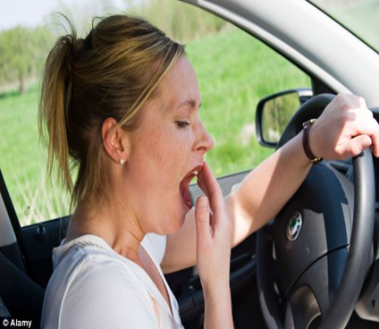
Introduction & definitions
Def:
More than feeling tired & drowsy. State of mental & physical exhaustion
Loss of alertness, drowsy, driving, working & feeling a sleep
Fatigue and tiredness are signals from our body that we need to sleep.

Slide 4
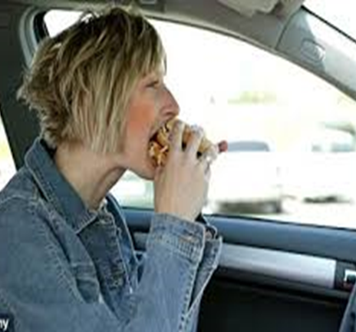


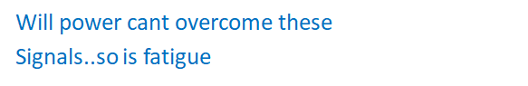
Cont,
Water we feel thirsty

Slide 5
Current millenium
Kenyans live busy lives; trying to balance the demands of family and work and leisure not easy
Economic pressure & expected demands means people generally working longer hours than a couple of years ago
Many are getting less sleep. Before modern world had electricity sleep was 9 hrs average;1950’s 7- 8 hrs; people lived longer and health; they were jovial. Today more consider 8 hrs sleep a luxury; stress, poor memory and headache etc are the repercussions
Trucks are becoming mobile warehouses as sellers keep minimum stocks and work on just-in-time principle. Meaning more pressure on companies and implementers with expectations of longer hours on the laptop, calls or behind the wheel.

Slide 6
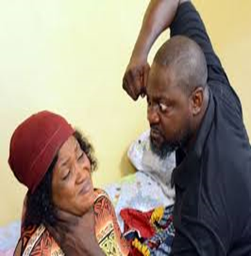
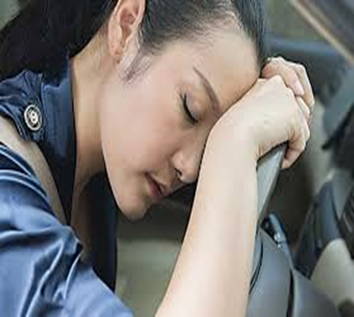
Short term effect of fatigue
Growling at a colleague, customer and family members
Loss of alertness & poor judgment
Slower reaction time
Poor memory
Bad moods
Overreacting
Blurred vision
You miss your turning point
one sleepless night can have an effect similar to drinking too much alcohol

Slide 7
Long term effects
Heart diseases
Diabetes
High blood pressure
Gastrointestinal disorders
Lower fertility & Immune systems
Anxiety
depresion

Slide 8
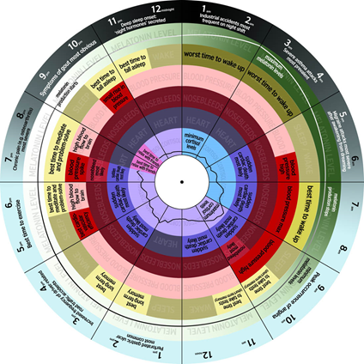
What causes fatigue- Body clock factor
Your body runs on a natural biological cycle of 24-26 hours. This is called circadian rhythm( about a day)
We all have body clock. Your body clock synchronizes your body rhythms & helps you to conserve resources when the rhythms are out of “synch” you get affected.

Slide 9
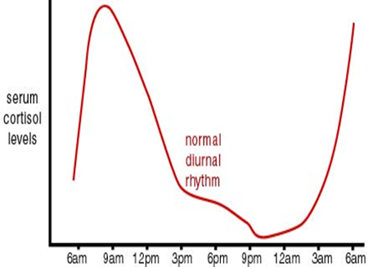
Cont,
Your body clock programs you to sleep at night and stay awake during the day. Inside your brain above your eyes is a group of 10000 nerves cells that program you to respond to night & day as the seasons changes

Slide 10
Cont,
People who have to work at night have trouble adjusting their body clocks no matter how much sleep you get before hand, you will feel sleepy during 1- 6am period.
1- 6 am is the critical time
Even if you consider yourself to be a night “owl” “kiwugulu- kiganda” you can't change your body clock to become a totally night person. You can't reverse your body clock

Slide 11
Sleep factor
There is only one cure to fatigue..Its sleep
7-7.5 hrs is considered an average
“ but remember no matter what the job pressure, your job not worth dying for and your family really can't do without you
Taking a nap can compensate for those nights. But remember naps are not substitute for 7 hours of continuous sleep at night
Sleep debt is like a bank loan; you have to pay it back
It's not good taking sleep tablets
Medical sleep problem; 10% of employees have treatable medical conditions…consult your Dr.
Narcolepsy- falling asleep during the day without obvious sleeping problem at night

Slide 12
Ways of reducing fatigue
Listen to the tick of your body clock
Don’t mess around with your body clock
Get rid of your sleep debt
Avoid getting/going into the parties if they will eat your sleep time
Plan your trip
Learn to recognize signs of your sleep
Eat sensibly & at regular times- you don’t have to be an overweight to be a driver- drink plenty of water
exercise
Talk to your family well in advance
Be realistic how much sleep you require
Start your work without sleep debt
Take regular power naps
Keep your office at a comfortable temperature
Never drink alcohol when driving

Slide 13
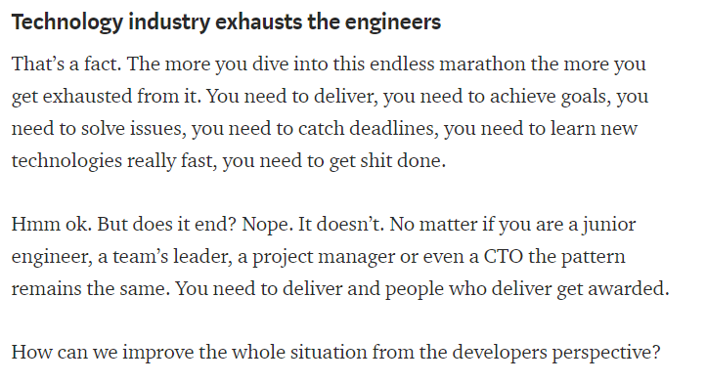
Cont.,

Slide 14
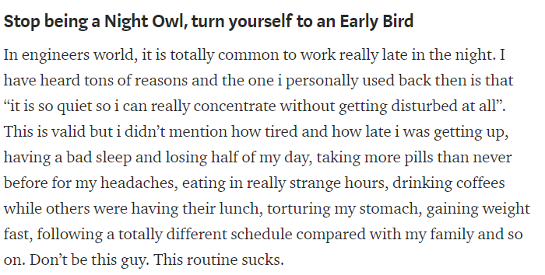
Cont.,

Slide 15
Thank
Q&A

Slide 16
HSE KOKO Networks

